Slide 1
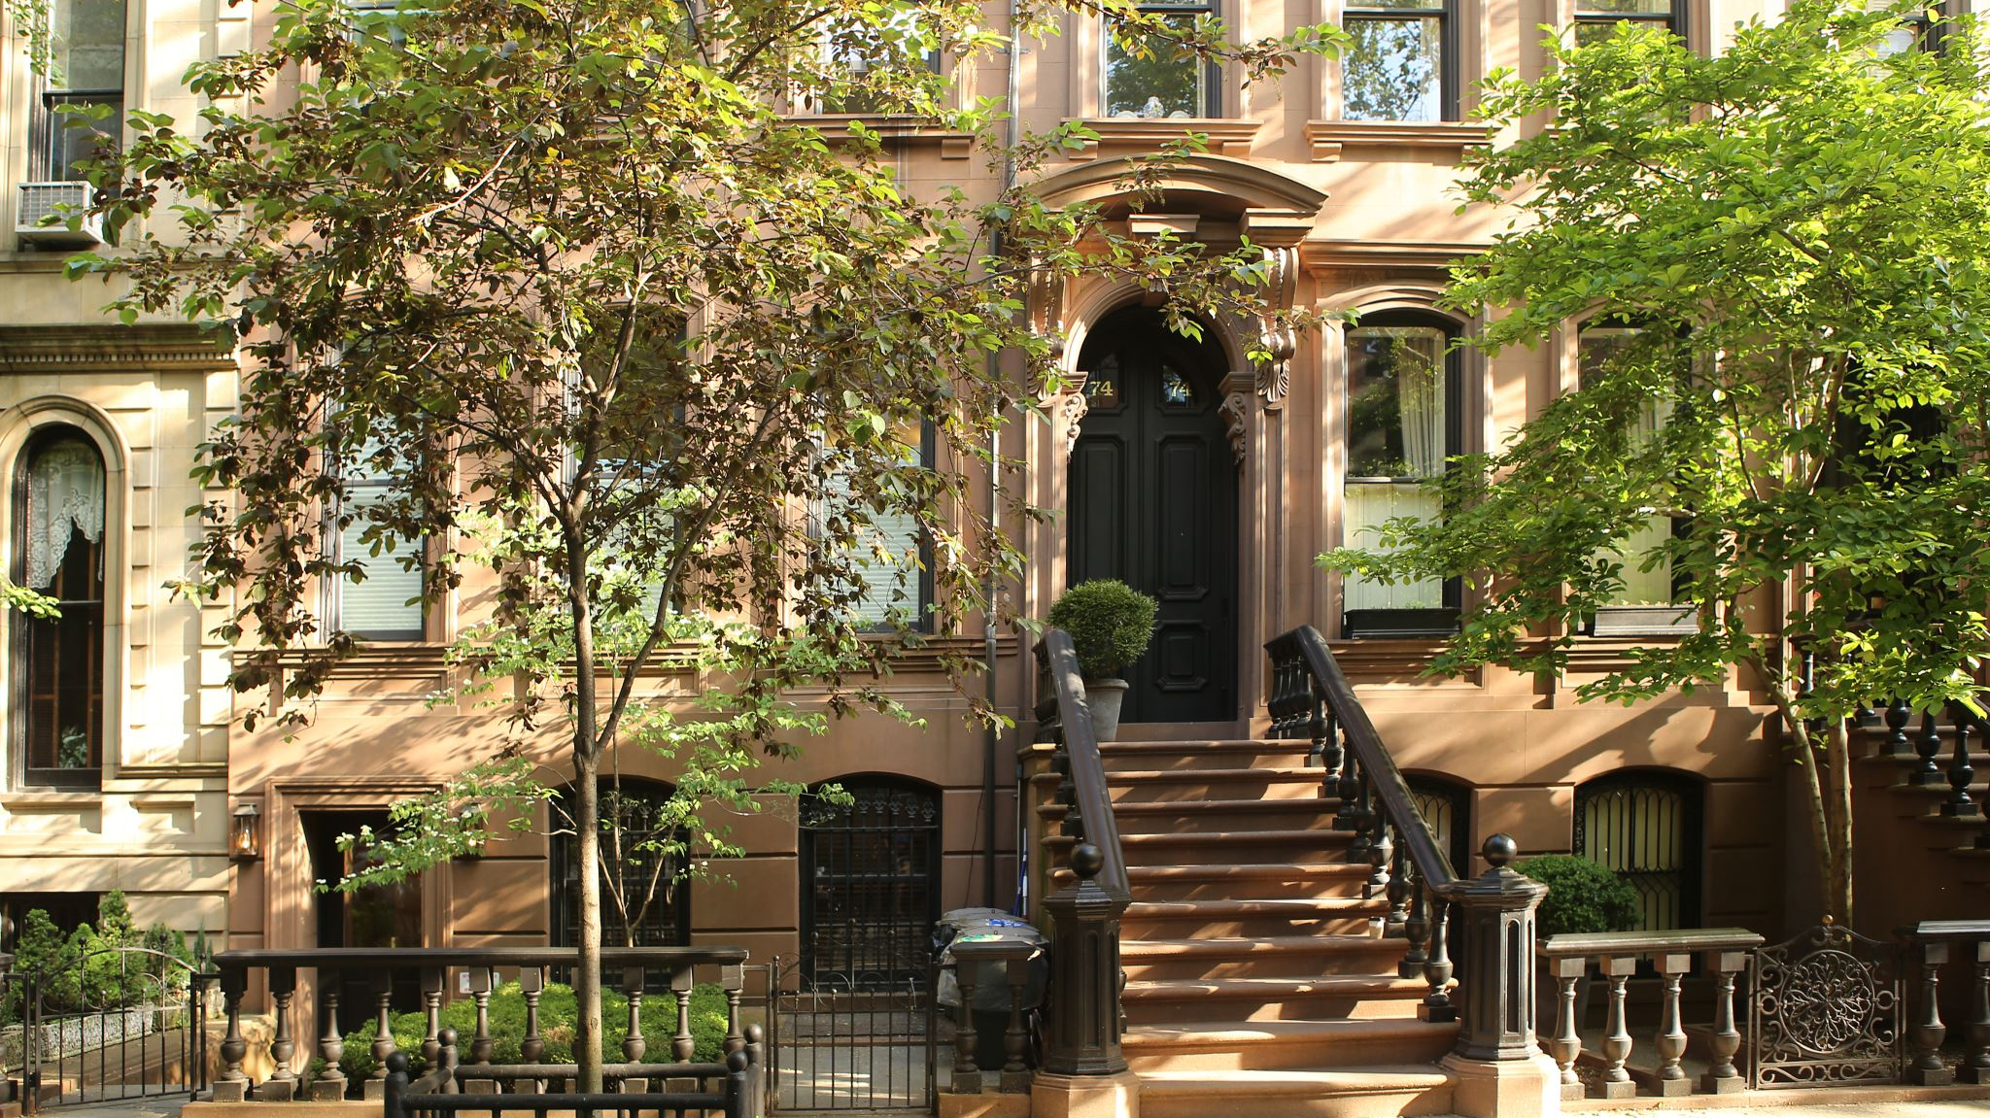
Larry Sanders's Dream Home
A real estate market analysis of king county - washington

Slide 2
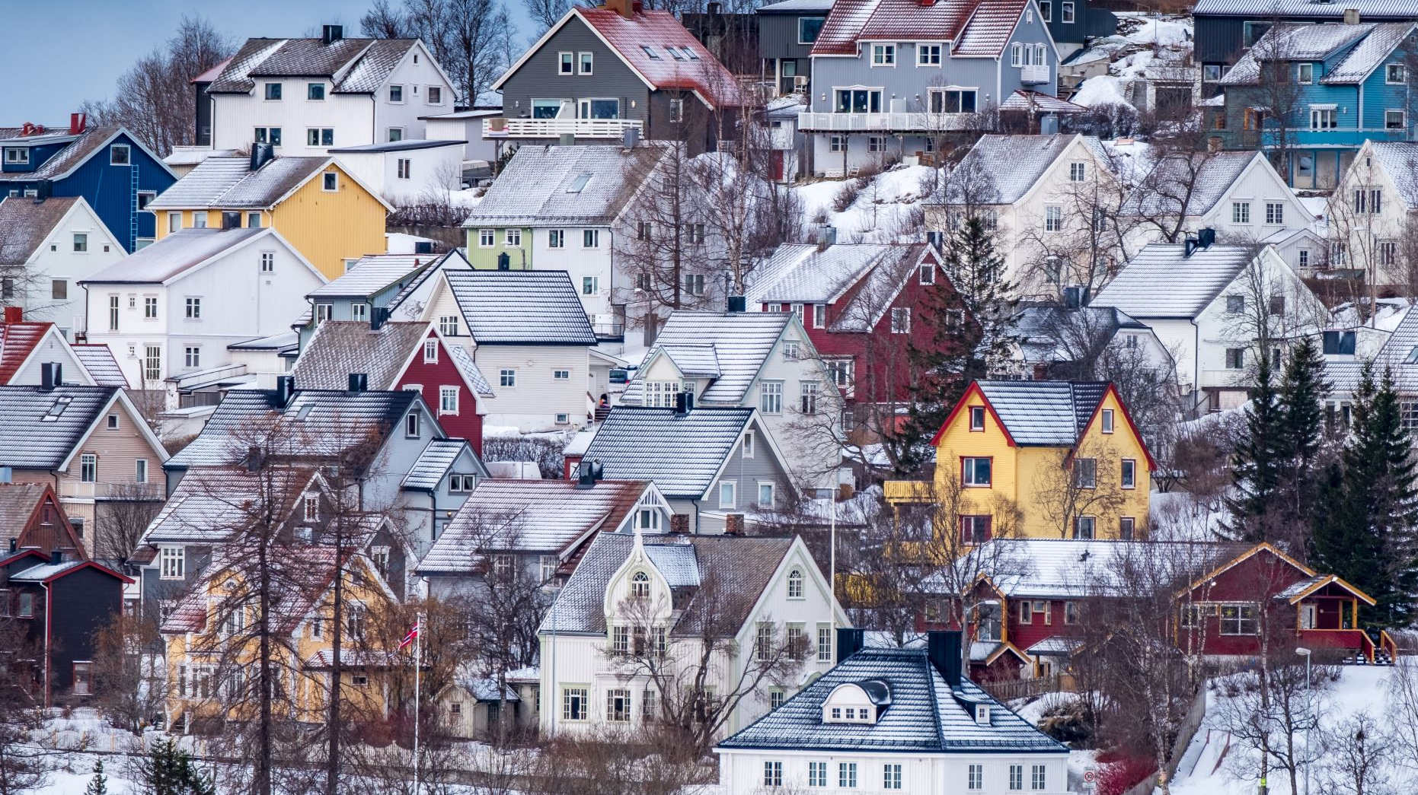
Agenda
King County – Interesting facts
Client’s requirements for property acquisition
Squarefoot Price x Renovation Status on Waterfront Properties
Seasonal Pricing Analysis – Advantage of a Winter Purchase
Analysis of Central Area Demographics
Final Recommendations

Slide 3

King county
One of the healthiest Counties in the USA, where life expectancy reaches 82.3 years, way above national average.
Wealthy area, where median household income is also above national average, and reaches $122,148 per household.
Source: https://datausa.io/

Slide 4

Client’s requirements for property acquisition
Waterfront home
Limited Budget
Nice & Isolated Property
Central Neighborhood
No kids Neighborhood
* Added Value Criteria: Minimum of 3 Bedrooms (for client’s kids) and Recently Renovated homes (less risk of germ contamination).

Slide 5
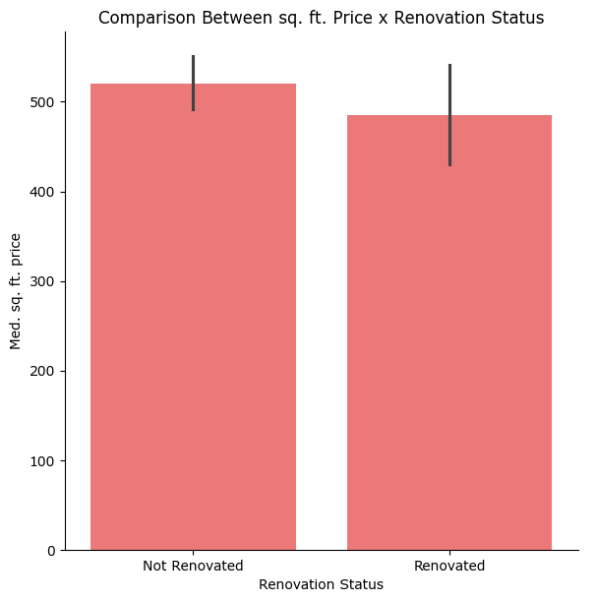
First hypothesis: If a Waterfront house is not renovated, the price is cheaper.
Out of all houses available, we have analyzed only the waterfront ones
We found out that the hypothesis is proved false:
Med. sq. ft. price for renovated homes ($471,70) is lower than Med. price for homes that have not been renovated ($532,26).
The false hypothesis is an advantage for Larry.

Slide 6
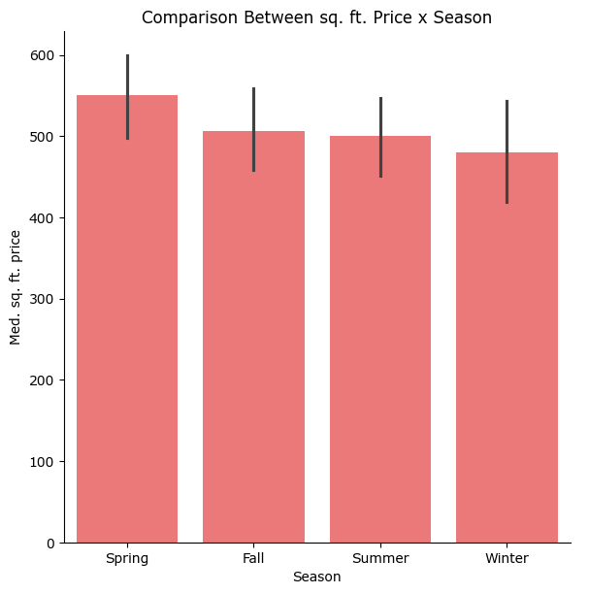
Second hypothesis: If the purchase is done during winter months, it is likely that prices will be lower.
For this analysis, we also only considered houses with waterfront.
It has been proven that the Median sq. ft. price for houses sold during Winter is indeed cheaper than during any other season.

Slide 7
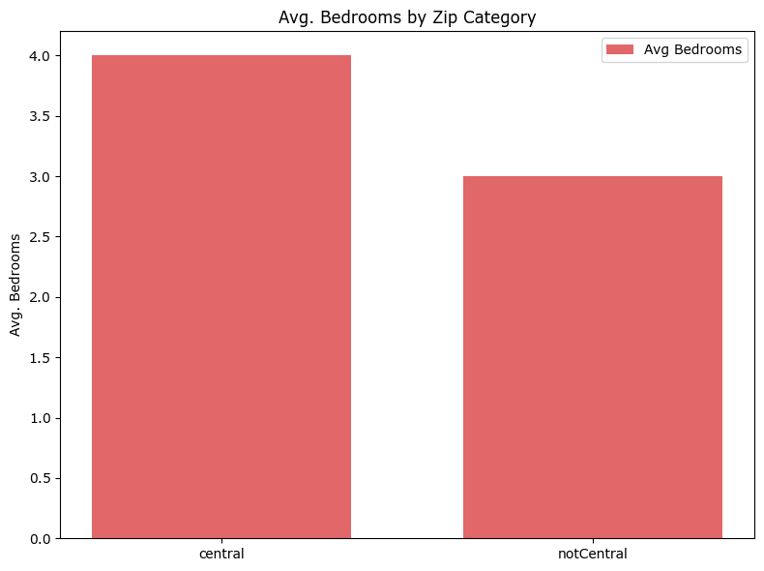
Third hypothesis: Houses closer to central areas tend to have fewer bedrooms, suggesting fewer families with children.
'Central’, in this analysis, consists of 31 Zip codes with closer location to Downtown Seattle. (Source for Zip Codes selection)
The third hypothesis is proven wrong: Central locations offer houses with more bedrooms than not Central ones.
Problem: How do we find a home with less children living close by?

Slide 8
Total Houses Analyzed Waterfront Houses Budget-Friendly Matches Quiet Zip Code Matches Recently Renovated Filtered (No Kids Areas
: 21597 : 146 : 21 : 21 : 2
: 21

